Slide 1

Managing Ocean Data Using Databases
Practical Guide to Scientific Data Architecture, Relational SQL, and ARGO Global Floats
PAVAN KUMAR JONNAKUTI
Scientist ‘C’, ODM
SPEAKER NOTES:
Welcome participants. Introduce the core premise: Modern oceanography is a data-intensive science. Today we bridges the gap between physical ocean observations and robust software databases using ARGO floats as our benchmark.

Slide 2




The Ocean Data Crisis: File Chaos
Imagine this real-world scenario: You are tasked with analyzing 10,000 autonomous ARGO float profiles scattered across thousands of folders as individual NetCDF, CSV, and Excel files.
The Core Questions We Must Answer
Key Challenges with File Stores
Slow Geographic Searches: Scanning 10,000 files to find Arabian Sea profiles takes minutes or hours.
How do I find all profiles from WMOID 2902092?
How do I count total active floats instantly?
How do I feed data directly into web dashboards?
Hard Parameter Filtering: Extracting temperature between 0–500m requires opening every single file into memory.
File Corruption & Concurrency: Two scientists editing metadata simultaneously overwrite each other.
SPEAKER NOTES:
Hook the audience by describing the frustration of opening 10,000 CSVs in Python or Excel. Ask students if they have experienced corrupt spreadsheets or missing metadata files.

Slide 3

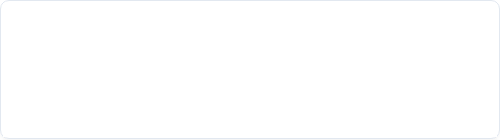

Anatomy of Oceanographic Data
Ocean data isn't just numbers—it is a structured blend of environmental observations, spatial positioning, sensor metadata, and quality flags.
Parameter | Sample Value | Data Type
Float WMOID | 2902092 | Integer (ID)
Latitude / Longitude | 15.25°N, 72.45°E | Spatial Coordinate
Profile Timestamp | 2026-08-20 06:00 | DateTime
Pressure (Depth) | 100.0 dbar | Float (Numeric)
Temperature | 27.4 °C | Float (Numeric)
Salinity | 35.6 PSU | Float (Numeric)
Dissolved Oxygen | 210.0 µmol/kg | Float (Numeric)
Data Classification Spectrum
1. Raw Telemetry: Uncalibrated signal directly from satellite link. 2. Metadata: Float model, sensor serial numbers, deployment date. 3. Quality-Controlled (QC): Data flagged for sensor drift or anomalies. 4. Derived Products: Interpolated gridded fields (e.g., RG-Argo Climatology).
Scale Insight: Over 4,000 active ARGO floats transmit profile data every 10 days, generating millions of records annually. File systems crumble under this volume.
SPEAKER NOTES:
Break down the ARGO data structure. Explain that every physical measurement (like Temperature) is meaningless without its metadata context (Latitude, Longitude, Timestamp, Depth).

Slide 4

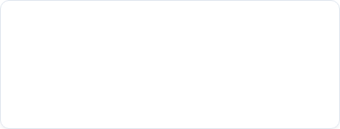

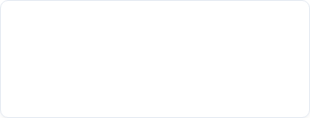
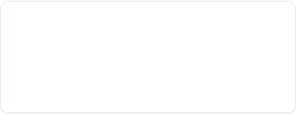
The 8 Pillars of Database Systems
1. Central Storage
2. Sub-second Search
3. Complex Filtering
Eliminates duplicated files across local hard drives. Single source of truth for all research teams.
Indexes allow searching billions of rows in milliseconds without reading the entire dataset.
Query simultaneously by date range, geographic bounding box, depth, and QC flags.
4. Concurrency
5. Data Integrity
6. API Integration
Hundreds of scientists, APIs, and models can read and write data simultaneously without crashes.
Enforces rules (e.g., salinity cannot be negative) preventing corrupted data from entering the system.
Directly connects to web apps, Python script pipelines, GIS tools, and machine learning models.
SPEAKER NOTES:
Walk through these 6 core pillars (along with Security and Scalability). Emphasize that databases do not just store data; they actively manage and protect it.

Slide 5



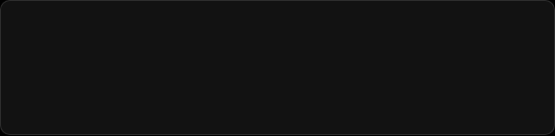
Deconstructing the Database Architecture
A Database is an organized collection of structured data. A DBMS (Database Management System) is the software engine that interacts with users, applications, and the database itself.
Popular RDBMS Engines
• PostgreSQL: Open-source, gold standard for scientific & GIS spatial data (PostGIS). • MySQL / MariaDB: Lightweight, widely deployed in web services. • SQLite: Serverless, embedded file-based relational database.
Data to User Value Chain
ARGO Telemetry ↓ PostgreSQL Database (DBMS) ↓ FastAPI / REST Service ↓ Web Dashboard / Python Client ↓ Researcher / Decision Maker
Relational vs. NoSQL
• Relational (SQL): Strict schema, tables, foreign keys. Perfect for ARGO profiles. • NoSQL (MongoDB): Unstructured document store. Good for raw JSON telemetry logs.
SPEAKER NOTES:
Clarify the terminology: Data vs Database vs DBMS vs Application. Distinguish relational tabular databases from document stores.

Slide 6

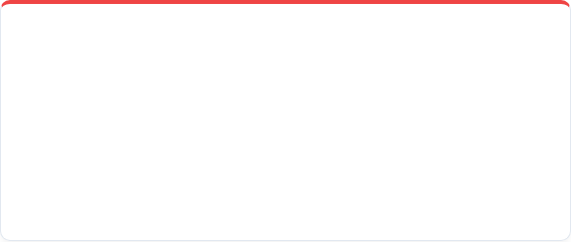
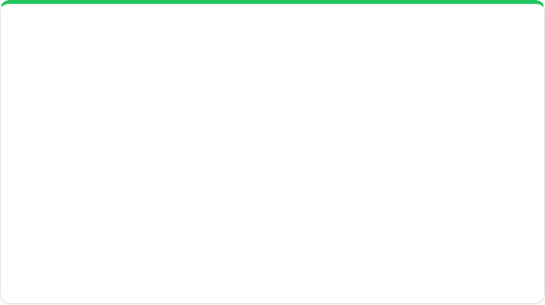
Database Design: Normalizing ARGO Data
The Pitfall: Storing everything in one giant flat table repeats float metadata millions of times. The Solution: Database Normalization (splitting data into logical related tables).
Bad Approach: Single Flat Table
Good Approach: Normalized Relational Tables
WMOID | Lat | Lon | Date | Depth | Temp
2902092 | 15.25 | 72.45 | 2026-08-20 | 10m | 28.1
2902092 | 15.25 | 72.45 | 2026-08-20 | 50m | 27.8
2902092 | 15.25 | 72.45 | 2026-08-20 | 100m | 27.4
1. ARGO_PROFILE Table (Metadata)
profile_id (PK) | wmoid | date | lat | lon
10001 | 2902092 | 2026-08-20 | 15.25 | 72.45
2. ARGO_OBSERVATION Table (Measurements)
Redundant storage of WMOID, Lat, Lon, Date for every single depth layer!
obs_id | profile_id (FK) | depth | temp | salinity
1 | 10001 | 10 dbar | 28.1 | 35.4
2 | 10001 | 50 dbar | 27.8 | 35.5
SPEAKER NOTES:
Explain normalization simply: Avoid storing the same latitude/longitude/date hundreds of times for every depth layer of a single profile. Use Primary Keys (PK) and Foreign Keys (FK).

Slide 7





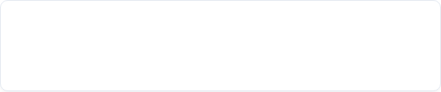
Relational Architecture: 1-to-Many Model
ARGO_FLOAT
ARGO_PROFILE
ARGO_OBSERVATION
1 : Many
1 : Many
🔑 wmoid (PK) • float_type • deploy_date • status
🔑 profile_id (PK) 🔗 wmoid (FK) • cycle_number • profile_date • latitude, longitude
🔑 obs_id (PK) 🔗 profile_id (FK) • pressure (dbar) • temperature (°C) • salinity (PSU)
Primary Key (PK)
Foreign Key (FK)
A unique identifier for every row in a table. Guaranteed to be non-null and distinct (e.g., `profile_id = 10001`).
A field referencing the Primary Key of another table. Maintains relational integrity across the profile and observation levels.
SPEAKER NOTES:
Trace a single float: 1 Float (2902092) performs Many Profiles (Cycles 1 to 200). Each Profile contains Many Observations (0 to 2000 meters depth).

Slide 8


SQL Essentials I: Table Creation & Data Ingestion
1. CREATE TABLE Schema
2. INSERT INTO Statements
Integrity Guarantee: SQL prevents inserting observations for a `profile_id` that doesn't exist in `argo_profile`!
SPEAKER NOTES:
Explain SQL data types: INTEGER, REAL (floating point), DATE, and the `REFERENCES` keyword which enforces relational integrity between profiles and observations.

Slide 9


SQL Essentials II: Filtering & Spatial Bounding
Find All Profiles for a Specific Float
Geographic Bounding Box Filter (Arabian Sea)
Temporal Filter (Year 2026 Observations)
Spatial Efficiency: Instead of writing complex Python loops opening file headers, a database resolves this spatial query in milliseconds using indexed columns.
SPEAKER NOTES:
Show how SQL plain language syntax (`SELECT`, `FROM`, `WHERE`, `BETWEEN`) simplifies complex spatial and temporal subsetting.

Slide 10

SQL Essentials III: Aggregations & Relational Joins
Count Profiles Per Float (Aggregation)
Relational JOIN (Combining Metadata & Readings)
Computes summary stats directly inside the database server.
SPEAKER NOTES:
Demonstrate how JOIN connects the profile metadata with physical depth readings seamlessly using the foreign key (`p.profile_id = o.profile_id`).

Slide 11

Databases vs. NetCDF Files: A Hybrid Synergy
Feature / Capability | Files (NetCDF / CSV / HDF5) | Relational Database (PostgreSQL)
Primary Purpose | Multidimensional array storage & archival | Fast indexing, querying, metadata & APIs
Search Speed | Slow (Must open and read files) | Blazing Fast (B-Tree & Spatial Indexes)
Concurrent Users | Poor (Risk of file locking/corruption) | Excellent (ACID Compliant Concurrency)
Data Integrity Rules | Manual (Application level checks) | Enforced (Constraints & Foreign Keys)
Web App Integration | Requires heavy preprocessing | Direct REST API / SQL connection
The Modern Architecture Solution: Co-existence
Databases do not replace NetCDF files! Instead, databases store profile metadata, spatial points, and indices. When a user requests raw binary ocean grids, the database provides the exact file path link to the NetCDF store.
SPEAKER NOTES:
Stress this critical point: NetCDF is fantastic for dense 4D array data (Gridded satellite models). Databases are fantastic for indexing, filtering, metadata search, and serving dashboards.

Slide 12

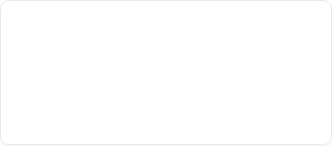

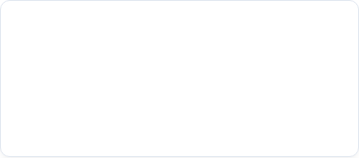
Real-World Applications in Oceanography
1. Global Data Portals
2. Real-Time Telemetry
3. Machine Learning Pipelines
Powers web portals like NOAA ERDDAP, Copernicus Marine Service, and INCOIS where users filter ocean observations by custom polygons.
Incoming satellite feeds from floats, gliders, and moorings automatically trigger QC script checks and push observations into live DB tables.
SQL pipelines extract clean, quality-controlled temperature profiles directly into PyTorch or TensorFlow ocean forecasting models.
SPEAKER NOTES:
Give examples of real operational portals (ERDDAP, INCOIS, Argo GDAC) that run database backends to serve millions of global users daily.

Slide 13



The Secret Sauce: Database Indexing Mechanics
Creating an Index on WMOID & Date
The Book Index Analogy
Imagine looking for the term "Salinity Anomaly" in a 1,000-page oceanography textbook. • Sequential Scan (No Index): Reading every single page from page 1 to 1000. • B-Tree Index: Turning straight to the index at the back, finding page 742, and jumping straight there instantly.
Performance Note: Without indexes, a query on 10 million rows scans 10M records. With B-Tree indexes, it finds the record in ~20 operations.
SPEAKER NOTES:
Explain B-Tree indexing using the book index analogy. Show how `CREATE INDEX` transforms slow table scans into sub-second lookups.

Slide 14







End-to-End Ocean Data System Architecture
Ingestion & QC
Relational DBMS
REST API
Python / NetCDF Parsing
PostgreSQL + PostGIS
FastAPI / Python
SPEAKER NOTES:
Walk through the complete pipeline from float satellite transmission to web visualizers. Highlight where PostgreSQL/PostGIS fits into the pipeline.

Slide 15

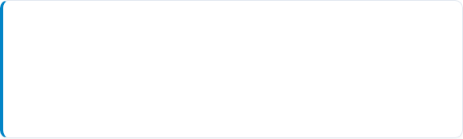
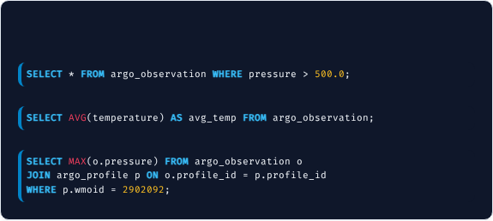
Interactive Challenge & Solutions
Student Exercise Prompts
Answer Key
Given the `argo_profile` and `argo_observation` tables, write SQL queries for:
1. Filter by Pressure
1.
Find all observations deeper than 500.0 dbar.
2.
Calculate the average water temperature across all observations.
2. Average Temperature Aggregation
3.
Find the maximum pressure reached by float 2902092.
3. Max Pressure with JOIN
SPEAKER NOTES:
Give students 2-3 minutes to attempt writing these queries on paper or in their heads, then reveal the SQL answer key on the right.

Slide 16


Summary & Next Steps
Key Takeaways
Recommended 2-Hour Hands-On Lab
Databases transition scientific data management from fragile file folders to robust, scalable platforms.
Step 1: Install PostgreSQL with PostGIS extension. Step 2: Use Python (`netCDF4` + `psycopg2`) to parse raw ARGO `.nc` files. Step 3: Ingest float profiles into relational tables. Step 4: Build a Streamlit web dashboard querying the database in real-time.
Relational schemas eliminate redundant data via normalized tables connected by Primary and Foreign Keys.
SQL empowers researchers to execute instantaneous spatial, temporal, and conditional subsetting.
SPEAKER NOTES:
Wrap up the lecture. Reinforce that database literacy is now an essential skill for modern oceanographers and environmental data scientists.

